Slide 1
PROGRAMMABLE PERIPHERAL INTERFACE -8255

Slide 2
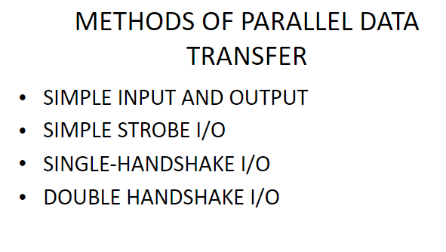

Slide 3
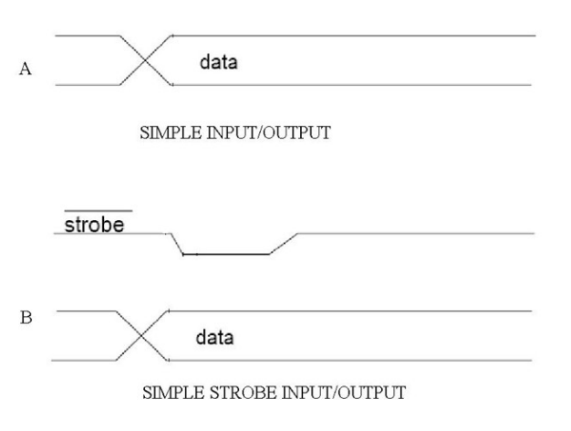

Slide 4
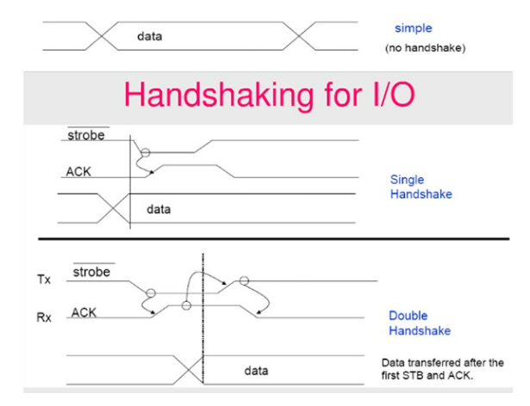

Slide 5
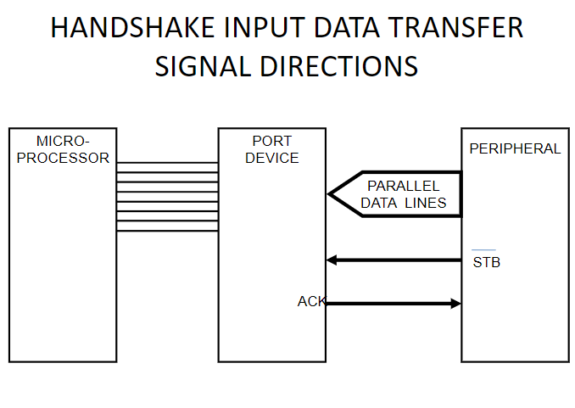

Slide 6
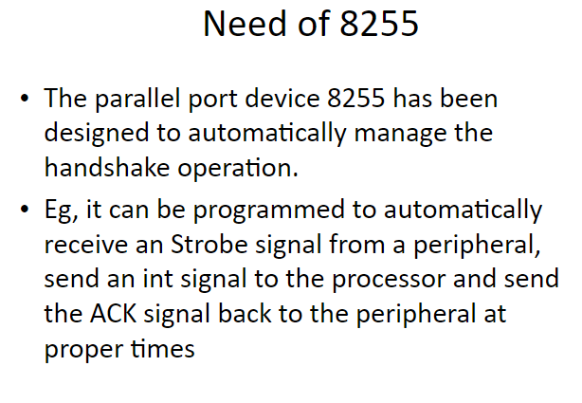

Slide 8
It is an I/O port chip used for interfacing I/O devices with microprocessor system.
It is device used to implement parallel data transfer between processor and slow peripheral devices like ADC, DAC, keyboard, 7-segment display,etc..

Slide 9
Features:
It is a programmable device.
It has 24 I/O programmable pins like PA,PB,PC (3-8 pins).
T T L compatible.

Slide 10
8255A has three ports
    PORT A
    PORT B
    PORT C
Port A and Port B are 8 bit parallel ports.
Port C can be split into two parts, i.e. PORT C lower (PC0-PC3) and PORT C upper (PC7-PC4) by the control word

Slide 11
These three ports are further divided into two groups,
  i.e. Group A includes PORT A and upper PORT C.
  Group B includes PORT B and lower PORT C
These two groups can be programmed in three different modes.

Slide 12
Three operating modes :
  Mode-0(simple I/O port)
  Mode-1(Handshake I/O port)
  Mode-2(Bidirectional I/O port)

Slide 13
Mode 0
In this mode, Port A and B is used as two 8-bit ports and Port C as two 4-bit ports.
Each port can be programmed in either input mode or output mode where outputs are latched and inputs are not latched.
Ports do not have interrupt capability.
Ports in mode 0 is used to interfaces LEDs, Hexa keypad and 7 segment LEDS to the processor.

Slide 14
Mode 1
In this mode, Port A and B is used as 8-bit I/O ports.
They can be configured as either input or output ports.
Each port uses three lines from port C as handshake signals.
Inputs and outputs are latched

Slide 15
MODE 1 :(Input/output with Hand shake)
In this mode, input or output is transferred by hand shaking Signals.
Handshaking signals is used to transfer data between whose data transfer is not same.
Computer
DATA BUS
STB
ACK
Busy
Printer

Slide 16
Example:
The computer send the data to the printer large speed compared to the printer.
When computer send the data according to the printer speed at the time only, printer can accept.
If printer is not ready to accept the data then after sending the data bus , computer uses another handshaking signal to tell printer that valid data is available on the data bus.
Each port uses three lines from port C as handshake signals

Slide 17
Mode 2
In this mode, Port A can be configured as the bidirectional port and Port B either in Mode 0 or Mode 1.
Port A uses five signals from Port C as handshake signals for data transfer.
The remaining three signals from Port C can be used either as simple I/O or as handshake for port B.

Slide 18
MODE 2:bi-directional I/O data transfer:
This mode allows bidirectional data transfer over a single 8-bit data bus using handshake signals.
This feature is possible only Group A
Port A is working as 8-bit bidirectional.
PC3-PC7 is used for handshaking purpose.
The data is sent by CPU through this port , when the peripheral request it.
CONTROL WORD FORMATS:
In the INPUT mode , When RESET is High all 24 pins (3-ports) be a input mode.

Slide 19
i.e all flip flops are cleared and the interrupts are reset.
This condition is maintained even after RESET goes low.
This can be avoid by writing single control word to the control registers , when required.

Slide 20
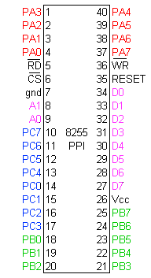
Pin Diagram

Slide 21
Function of pins:
Data bus(D₀-D₇):These are 8-bit bi-directional buses, connected to 8086 data bus for transferring data.
CS: This is Active Low signal. It stands for Chip Select. A LOW on this input selects the chip and enables the communication between the 8255 and the CPU.
Read: This is Active Low signal, when it is Low the microprocessor reads data from a selected I/O port of 8255A.
Write: This is Active Low signal, when it is Low the microprocessor writes data into a selected I/O port .

Slide 22
Address (A₀-A₁):This is used to select the ports.
A1 | A0 | Select
0 | 0 | PA
0 | 1 | PB
1 | 0 | PC
1 | 1 | Control reg.

Slide 23
RESET: This is used to reset the device. That means clear control registers.
PA₀-PA₇:It is the 8-bit bi-directional I/O pins used to send the data to peripheral or to receive the data from peripheral.
PB₀-PB₇:Similar to PA
PC₀-PC₇:This is also 8-bit bidirectional I/O pins. These lines are divided into two groups.
  PC₀ to PC₃(Lower Groups)
  PC₄ to PC₇ (Higher groups)
These two groups working in separately using 4 data’s.

Slide 24
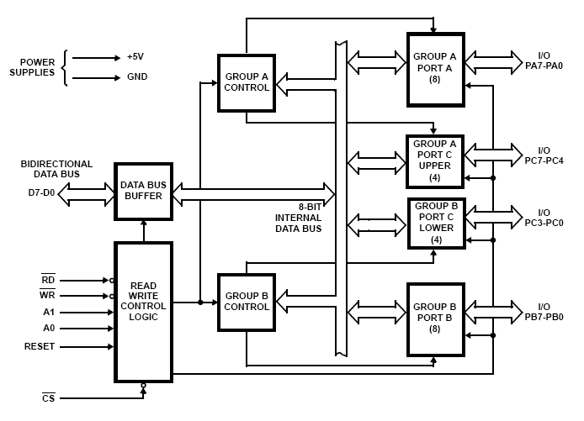
Block Diagram-8255

Slide 25
Data Bus buffer:
It is a 8-bit bidirectional Data bus.
Used to interface between 8255 data bus with system bus.
The internal data bus and Outer pins D₀-D₇ pins are connected in internally.
The direction of data buffer is decided by Read/Control Logic.

Slide 26
Read/Write Control Logic:
This is getting the input signals from control bus and Address bus
Control signal are RD and WR.
Address signals are A0,A1,and CS.
8255 operation is enabled or disabled by CS.

Slide 27
Group A and Group B control:
Group A and B get the Control Signal from CPU and send the command to the individual control blocks.
Group A send the control signal to port A and Port C (Upper) PC7-PC4.
Group B send the control signal to port B and Port C (Lower) PC3-PC0.
PORT A:
This is a 8-bit buffered I/O latch.
It can be programmed by mode 0 , mode 1, mode 2 .

Slide 28
PORT B:
This is a 8-bit buffer I/O latch.
It can be programmed by mode 0 and mode 1.
PORT C:
This is a 8-bit Unlatched buffer Input and an Output latch.
It is splitted into two parts.
It can be programmed by bit set/reset operation.

Slide 29
Operation modes in 8255
Two operating modes:
  I/O mode( mode 0, mode 1, mode2)
  Bit set/Reset mode

Slide 30
Operation modes:
BIT SET/RESET MODE:
The PORT C can be Set or Reset by sending OUT instruction to the CONTROL registers.
I/O MODES:
MODE 0(Simple input / Output):
In this mode , port A, port B and port C is used as individually (Simply).
Features:
Outputs are latched , Inputs are buffered not latched.
Ports do not have Handshake or interrupt capability.

Slide 31
Control words
Two control words:
  I/O mode set control word(MSW)
  Bit set/reset control word(BSR)
MSW is used to specify I/O functions.
BSR is used to set/reset individual pins of Port C.
Both the control words are written in the same control register.

Slide 32
8255 ports are programmed by writing control word in the control word in the control register.
For setting I/O functions and mode of operation the I/O mode set control word is send to control register.
For setting/ resetting pins of port C, the bit set/reset control word is send to control register.

Slide 33
FOR BIT SET/RESET MODE:
This is bit set/reset control word format.
X X X
Don’t care
Bit select
B0
B1
B2
D7 | D6 | D5 | D4 | D3 | D2 | D1 | D0
BIT SET/RESET
1=SET
0=RESET
0 | 1 | 2 | 3 | 4 | 5 | 6 | 7
0 | 1 | 0 | 1 | 0 | 1 | 0 | 1
0 | 0 | 1 | 1 | 0 | 0 | 1 | 1
0 | 0 | 0 | 0 | 1 | 1 | 1 | 1
BIT SET/RESET FLAG
=0 Active

Slide 34
PC0-PC7 is set or reset as per the status of D0.
A BSR word is written for each bit
Example:
  PC3 is Set then control register will be 0XXX0111.
  PC4 is Reset then control register will be 0XXX01000.
X is a don’t care.

Slide 35
FORMAT OF I/O MODE:
The mode format for I/O as shown in figure
D7 | D6 | D5 | D4 | D3 | D2 | D1 | D0
Group A
Port C Upper 1=Input 0=Output
Port B 1=Input 0=Output
Mode selection 00=mode 0 01=mode 1 1x=mode 2
Group B
Port C Lower 1=Input 0=Output
Port B 1=Input 0=Output
Mode selection 0=mode 0 1=mode 1
Mode set 1-I/O mode 0-BSR mode

Slide 36
The control word for both mode is same.
Bit D7 is used for specifying whether word loaded in to Bit set/reset mode or Mode definition word.
D7=1=Mode definition mode.
D7=0=Bit set/Reset mode.

